Slide 1
Data Structure Algorithms
Section 9 – binary Search tree ( Bst )

Slide 2
Binary Search Tree (BST) What is Binary Search Tree?
Basically Binary Search Tree is a Binary Tree.
Binary Search Tree (BST) is a Binary Tree in which all the nodes follows the bellow-mentioned properties:
The left sub-tree of a node has a key less than or equal to its parent node's key.
The right sub-tree of a node has a key greater than to its parent node's key.
Sample BST

Slide 3
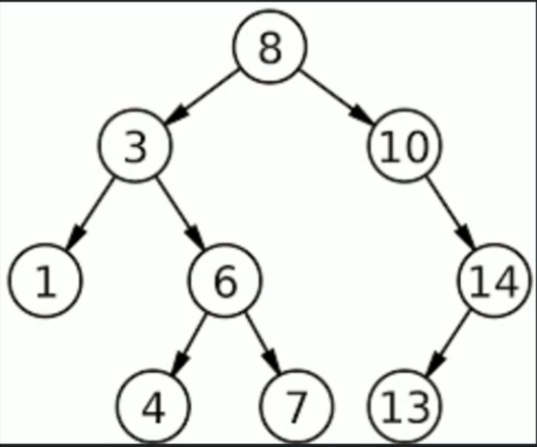
Binary Search Tree (BST) What is Binary Search Tree?

Slide 4
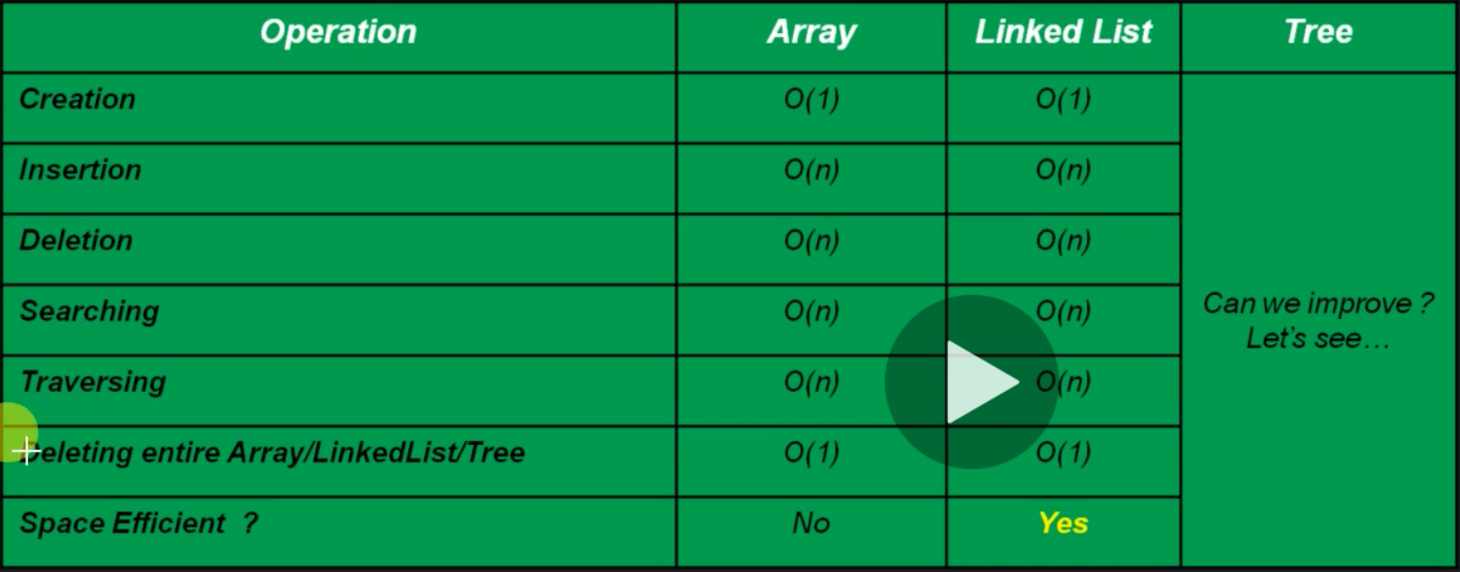
Why should we learn BST?

Slide 5
Common operations of BST
How the common operations can be performed in BST.
Creation of BST
Search for a value
Traverse all nodes
Insertion of a node
Deletion of a node
Deletion of BST

Slide 6
Algorithm - Creation of blank BST
createBST()
Initialize Root with null

Slide 7
Time & Space Complexity - Creation of blank BST:
createBST()
Initialize Root with null ------------------- O(1)
Time Complexity - O(1)
Space Complexity - O(1)

Slide 8
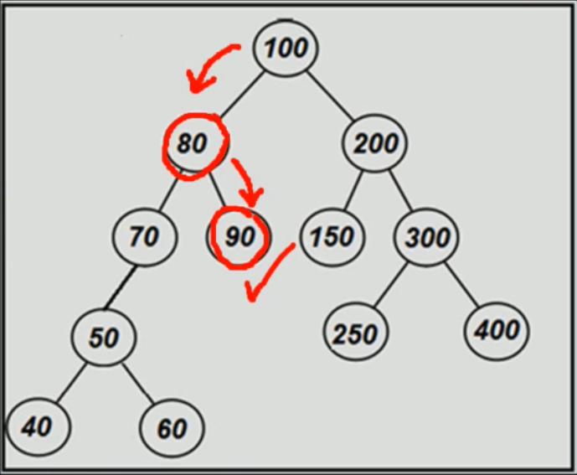
Searching a node in BST.
Note: The reason because we have to learn first Search a node in BST before inserting a node is that we have to search first for before inserting.

Slide 9
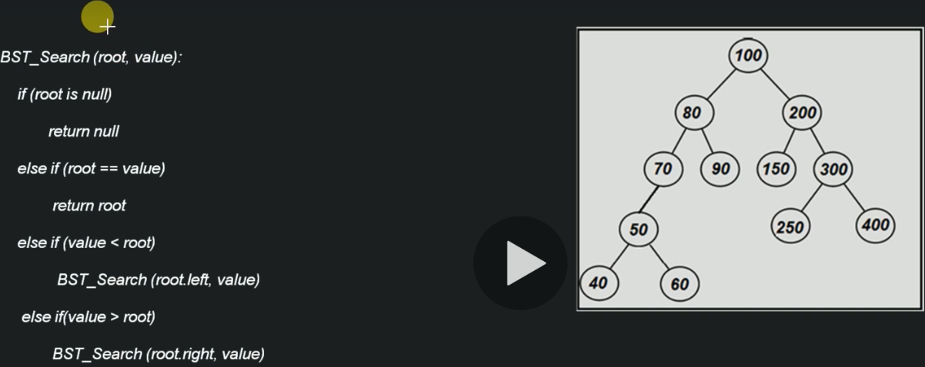
Algorithm - Searching a node in BST

Slide 10
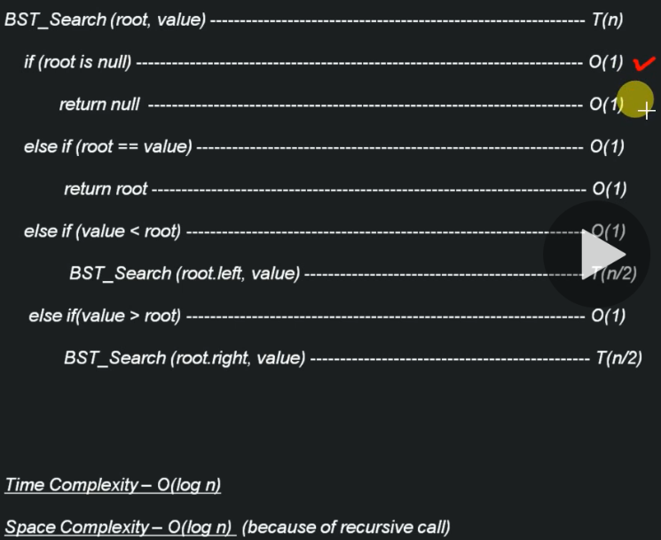
Time & Space Complexity - Searching a node in BST

Slide 11
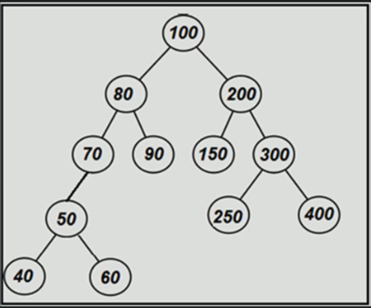
Traversal of BST
The 4 techniques to traverse a BST is exactly the same used to traverse Binary Tree.
Depth First Search
PreOrder Traversal
InOrder Traversal
PostOrder Traversal
Breadth First Search
LevelOrder Traversal

Slide 12
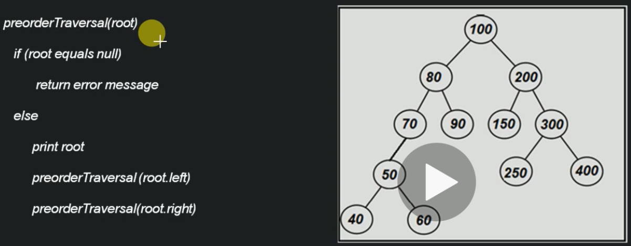
Algorithm – Pre-Order Traversal of BST

Slide 13
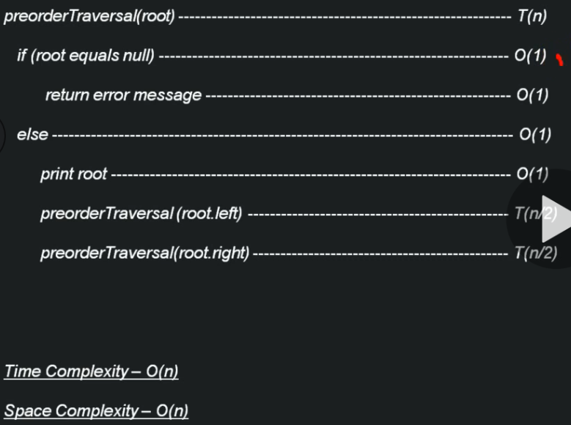
Time & Space Complexity – Pre-Order Traversal of BST

Slide 14
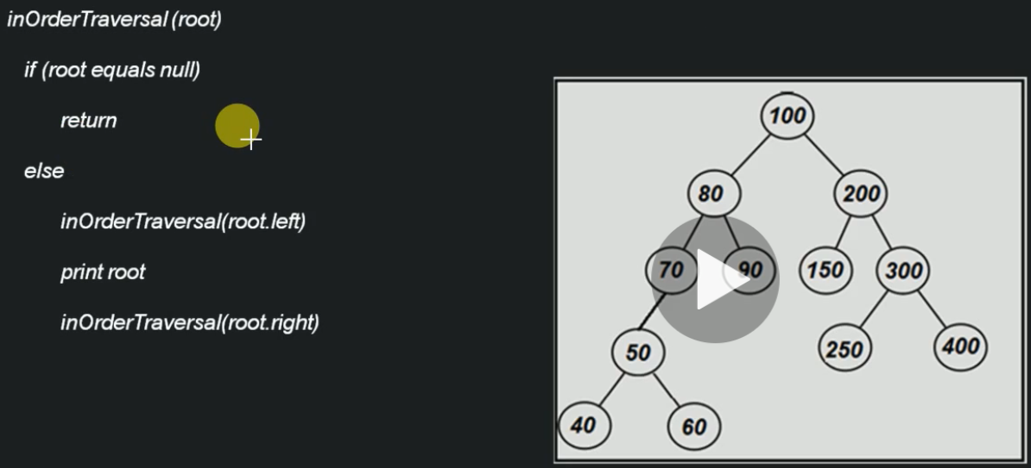
Algorithm – ‘InOrder Traversal’ of BST

Slide 15
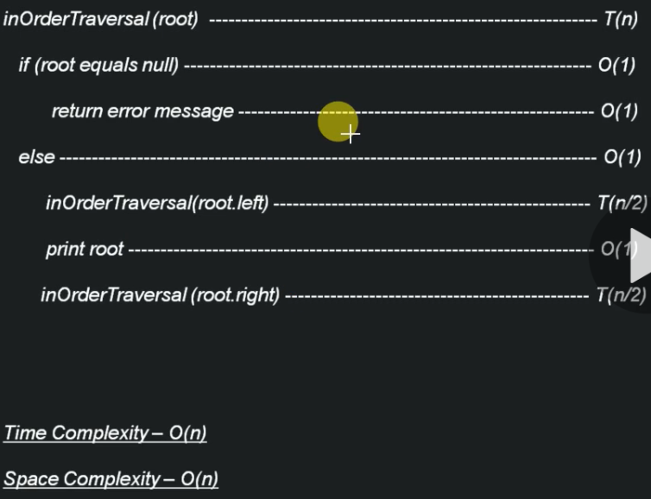
Time & Space Complexity – ‘InOrder Traversal’ of BST

Slide 16
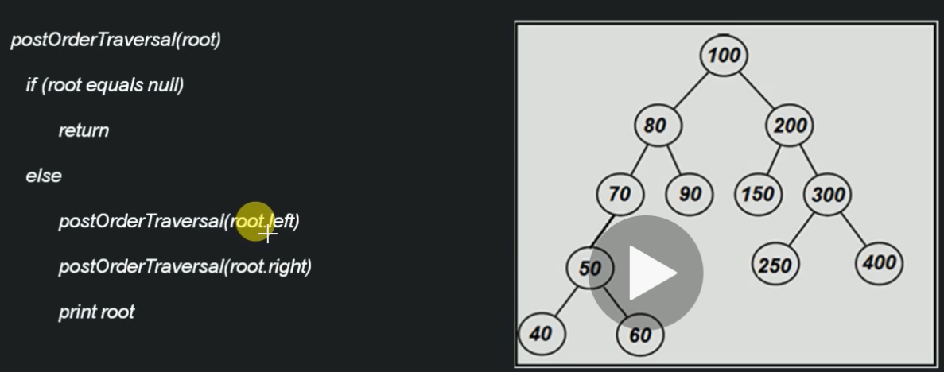
Algorithm – ‘PostOrder Traversal’ of BST

Slide 17
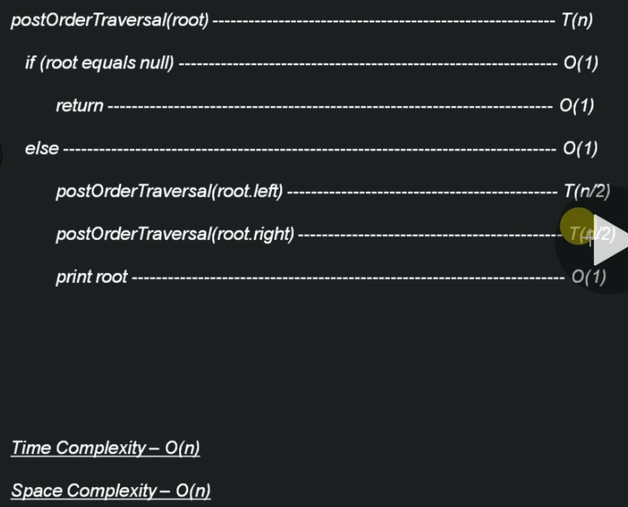
Time & Space Complexity – ‘PostOrder Traversal’ of BST

Slide 18
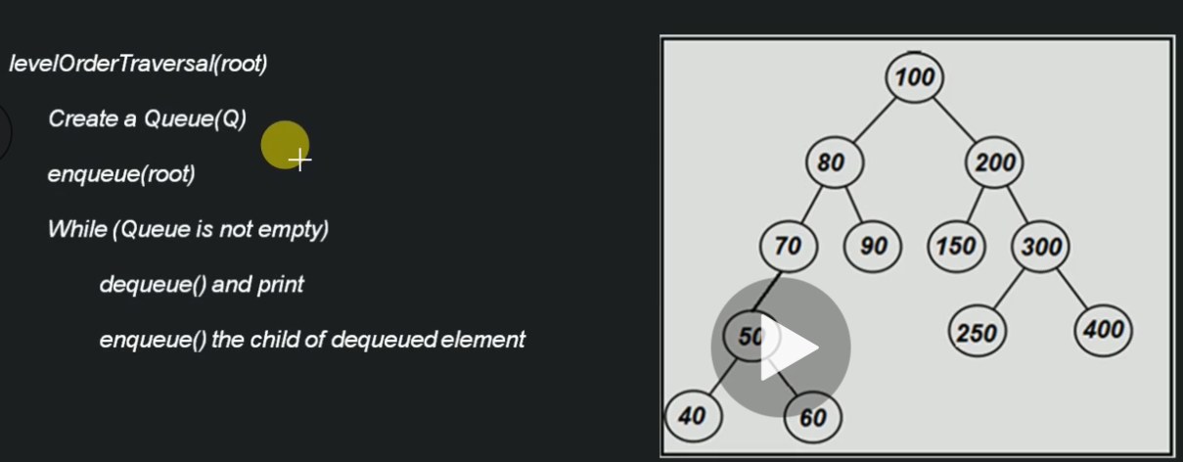
Algorithm – ‘Level Order Traversal’ of BST

Slide 19
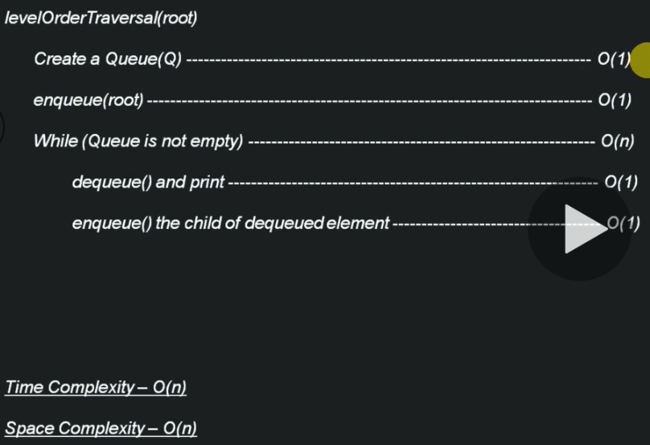
Time & Space Complexity – ‘Level Order Traversal’ of BST

Slide 20
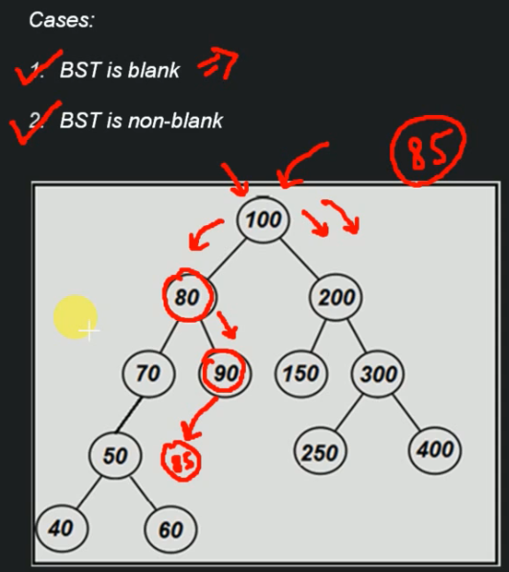
Inserting a node in BST
Cases:
BST is Blank
BST is non-blank
BST is Blank - We just need to create a node and add as a Root.

Slide 21
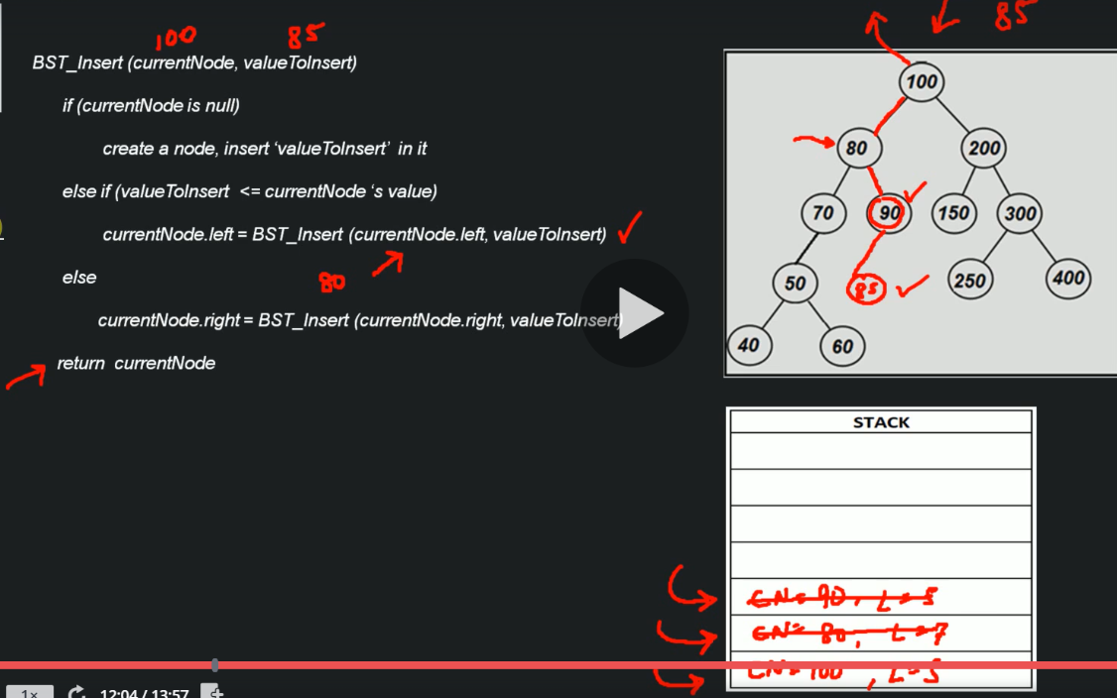
Algorithm - Inserting a node in BST

Slide 22
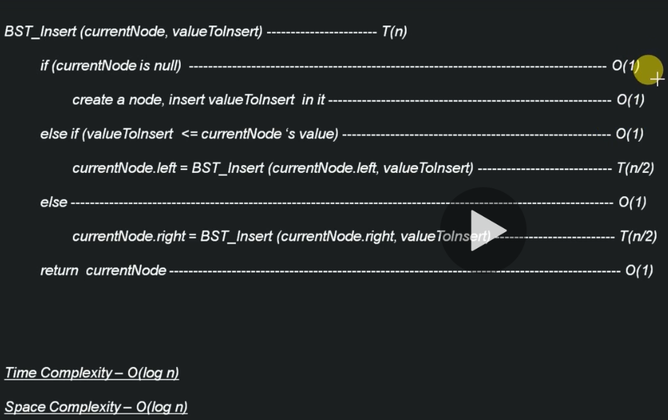
Time & Space Complexity - Inserting a node in BST

Slide 23
Deleting a Node From BST
Node to be deleted is leaf node
Node to be deleted is having 1 child
Node to be deleted has 2 children

Slide 24
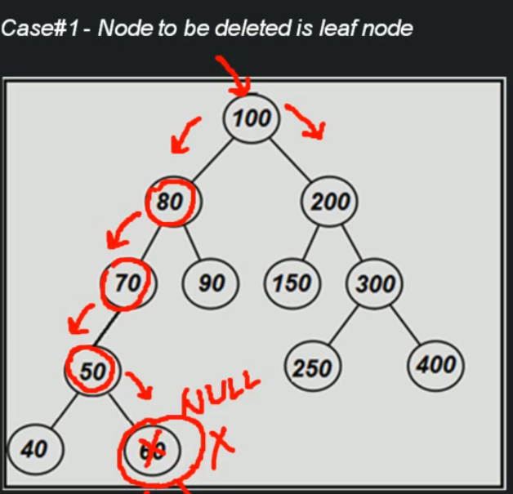
Deleting a Node From BST Case#1: Node to be deleted is leaf node

Slide 25
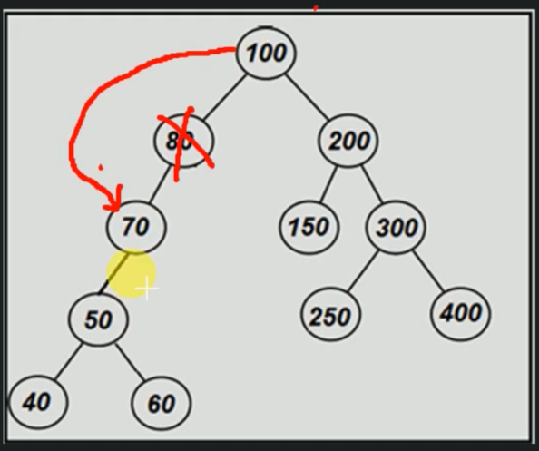
Deleting a Node From BST Case#2: Node to be deleted having 1 child

Slide 26
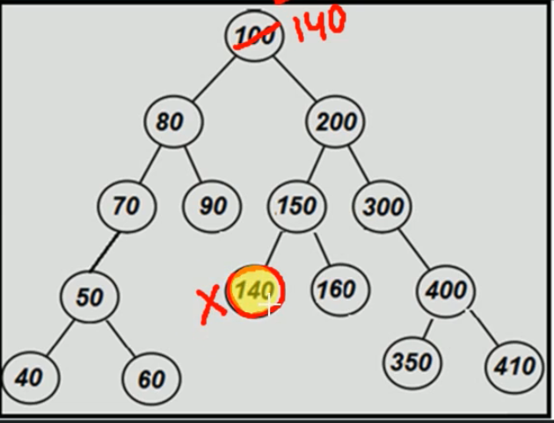
Deleting a Node From BST Case#3: Node to be deleted has 2 children
Note:
Example: I want to delete the 100 node. I have to find the successor.
The successor is the node 140.
The successor is the least value the right subtree.

Slide 27
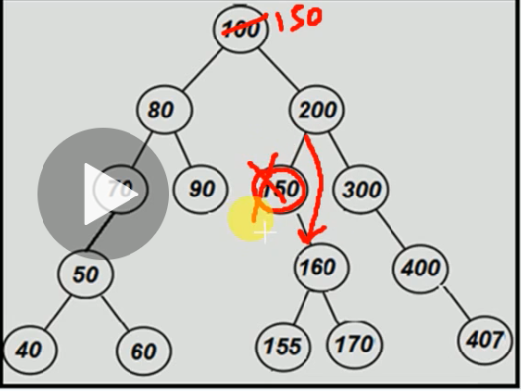
Deleting a Node From BST Case#3: Node to be deleted has 2 children

Slide 28
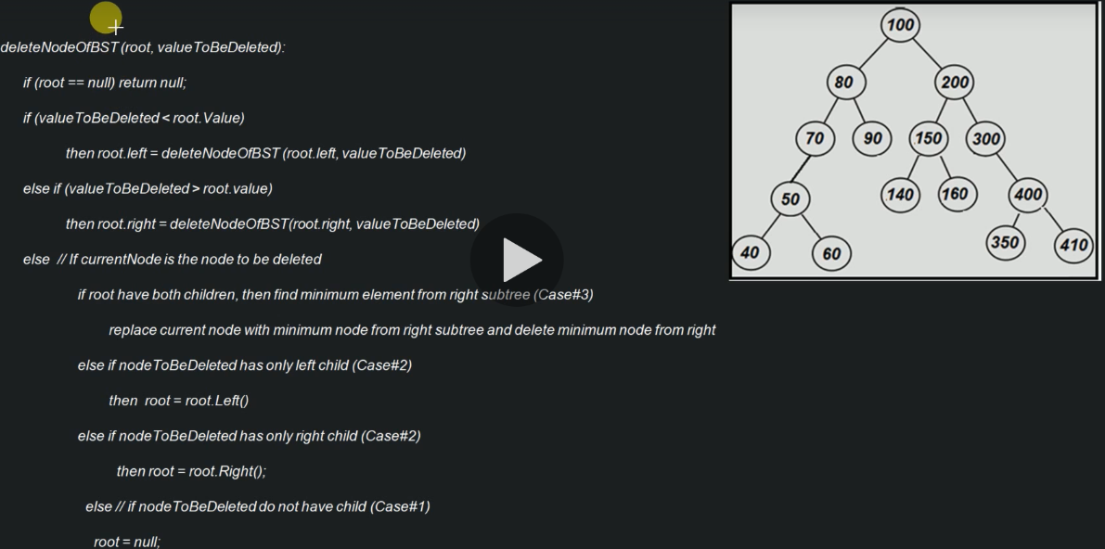
Algorithm – Deletion of a node from BST

Slide 29
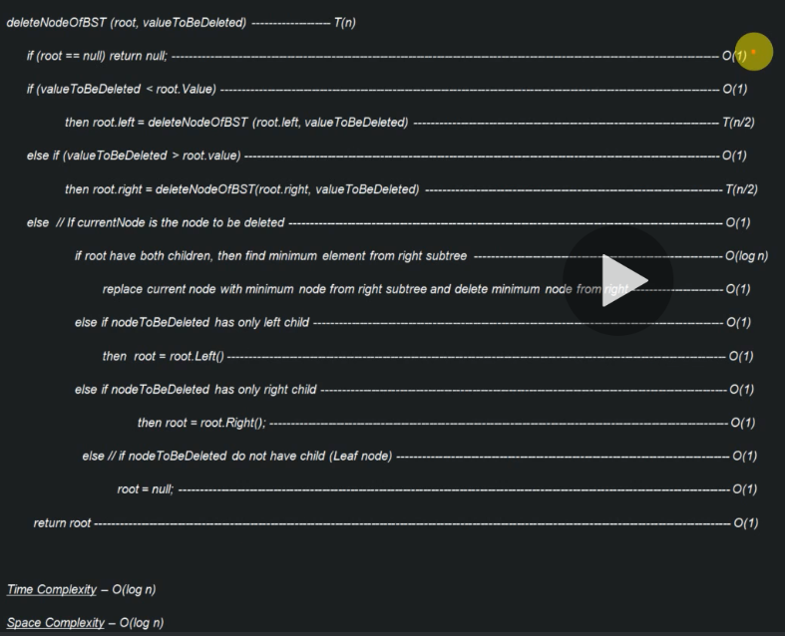
Time & Space Complexity – Deletion of a node from BST

Slide 30
Time & Space Complexity – Deletion of a node from BST

Slide 31
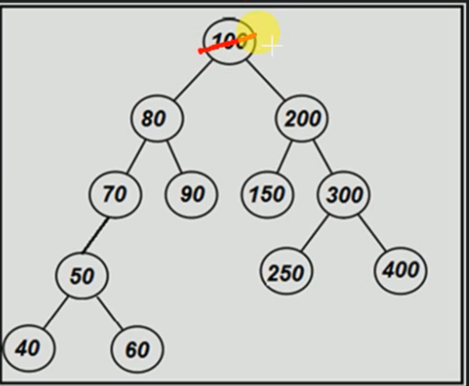
Algorithm - Deletion of entire BST:
Delete()
root = null
Note: If you delete the root all the entire tree is eligible for the garbage collector.

Slide 32
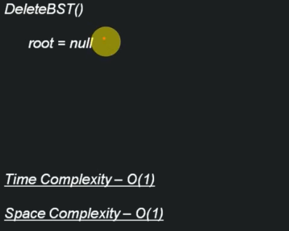
Time & Space Complexity - Deletion of entire BST:

Slide 33
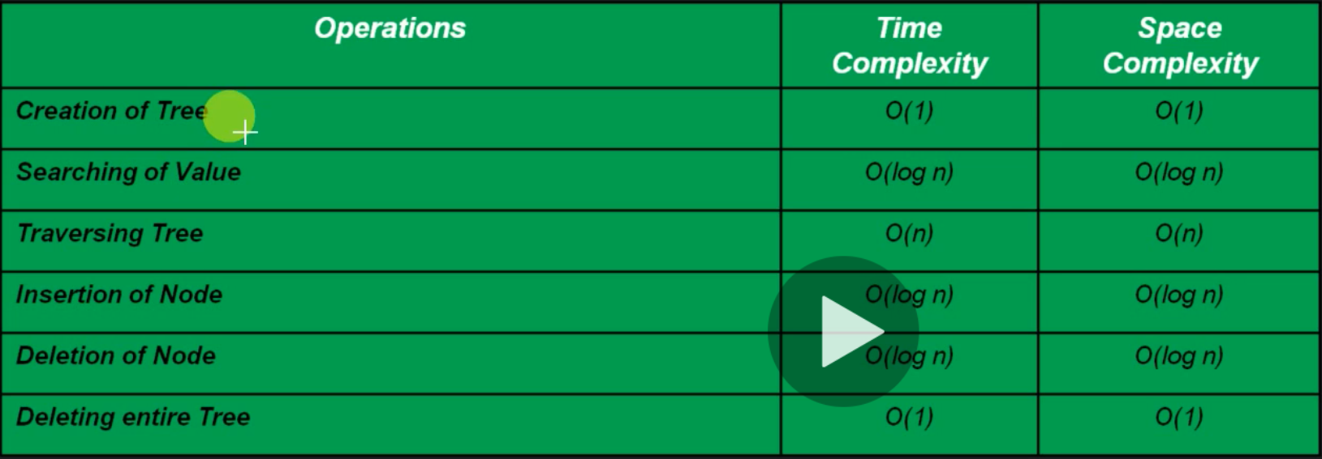
Time & Space Complexity of BST

